Slide 1
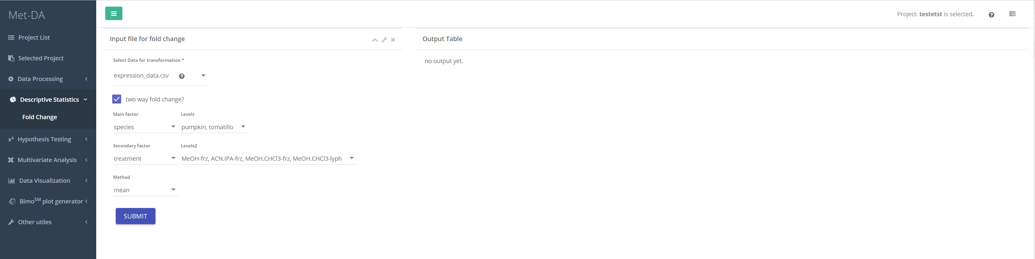
1

Slide 2
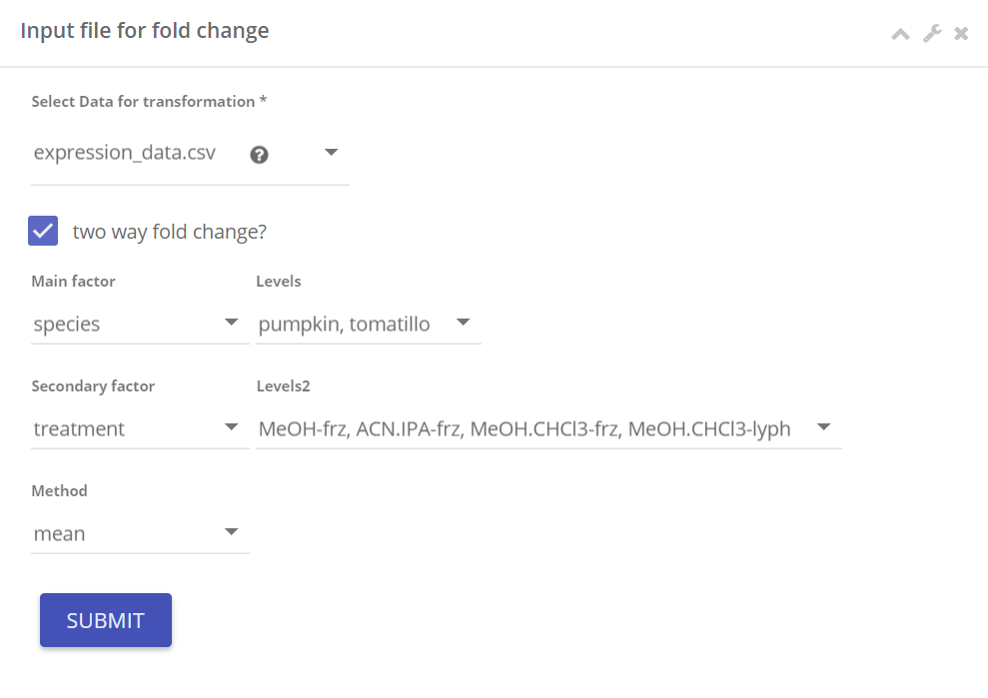
Data matrix
Two way fold change:
Checking this to calculate fold change of two-factors. For example, in this example data, we have species (first factor) of pumpkin vs tomatillo and treatment (second factor) MeOH-frz, ACN.IPA-frz, MeOH.CHCL3-frz, MeOH.CHCL3-lyph. By checking two way fold change, MetDA will calculate following fold changes for each compound,
Fold change on the first factor: average(pumpkin)/average(tomatillo)
Fold change on the second factor: average(MeOH-frz)/average(ACN.IPA-frz), average(MeOH-frz)/average(MeOH.CHCL3-frz), average(MeOH-frz)/average(MeOH.CHCL3-lyph), average(ACN.IPA-frz)/average(MeOH.CHCL3-frz), average(ACN.IPA-frz)/average(MeOH.CHCL3-lyph), average(MeOH.CHCL3-frz)/average(MeOH.CHCL3-lyph).
Fold change on the first factor at each level of second factor: average(pumpkin)/average(tomatillo) at MeOH-frz, etc. [calculating the fold change of pumpkin/ tomatillo using only MeOH-frz samples]
Fold change on the second factor at each level of first factor: average(MeOH-frz)/average(ACN.IPA-frz) at pumpkin, etc.
Without checking two way fold change, only one factor is needed to calculate fold change. For example, average(pumpkin)/average(tomatillo) .
Method:
Average measure can use either mean or median.
1

